Slide 1
Halloween, Darkness & Light

Slide 2
a. Table Discussions

Slide 3
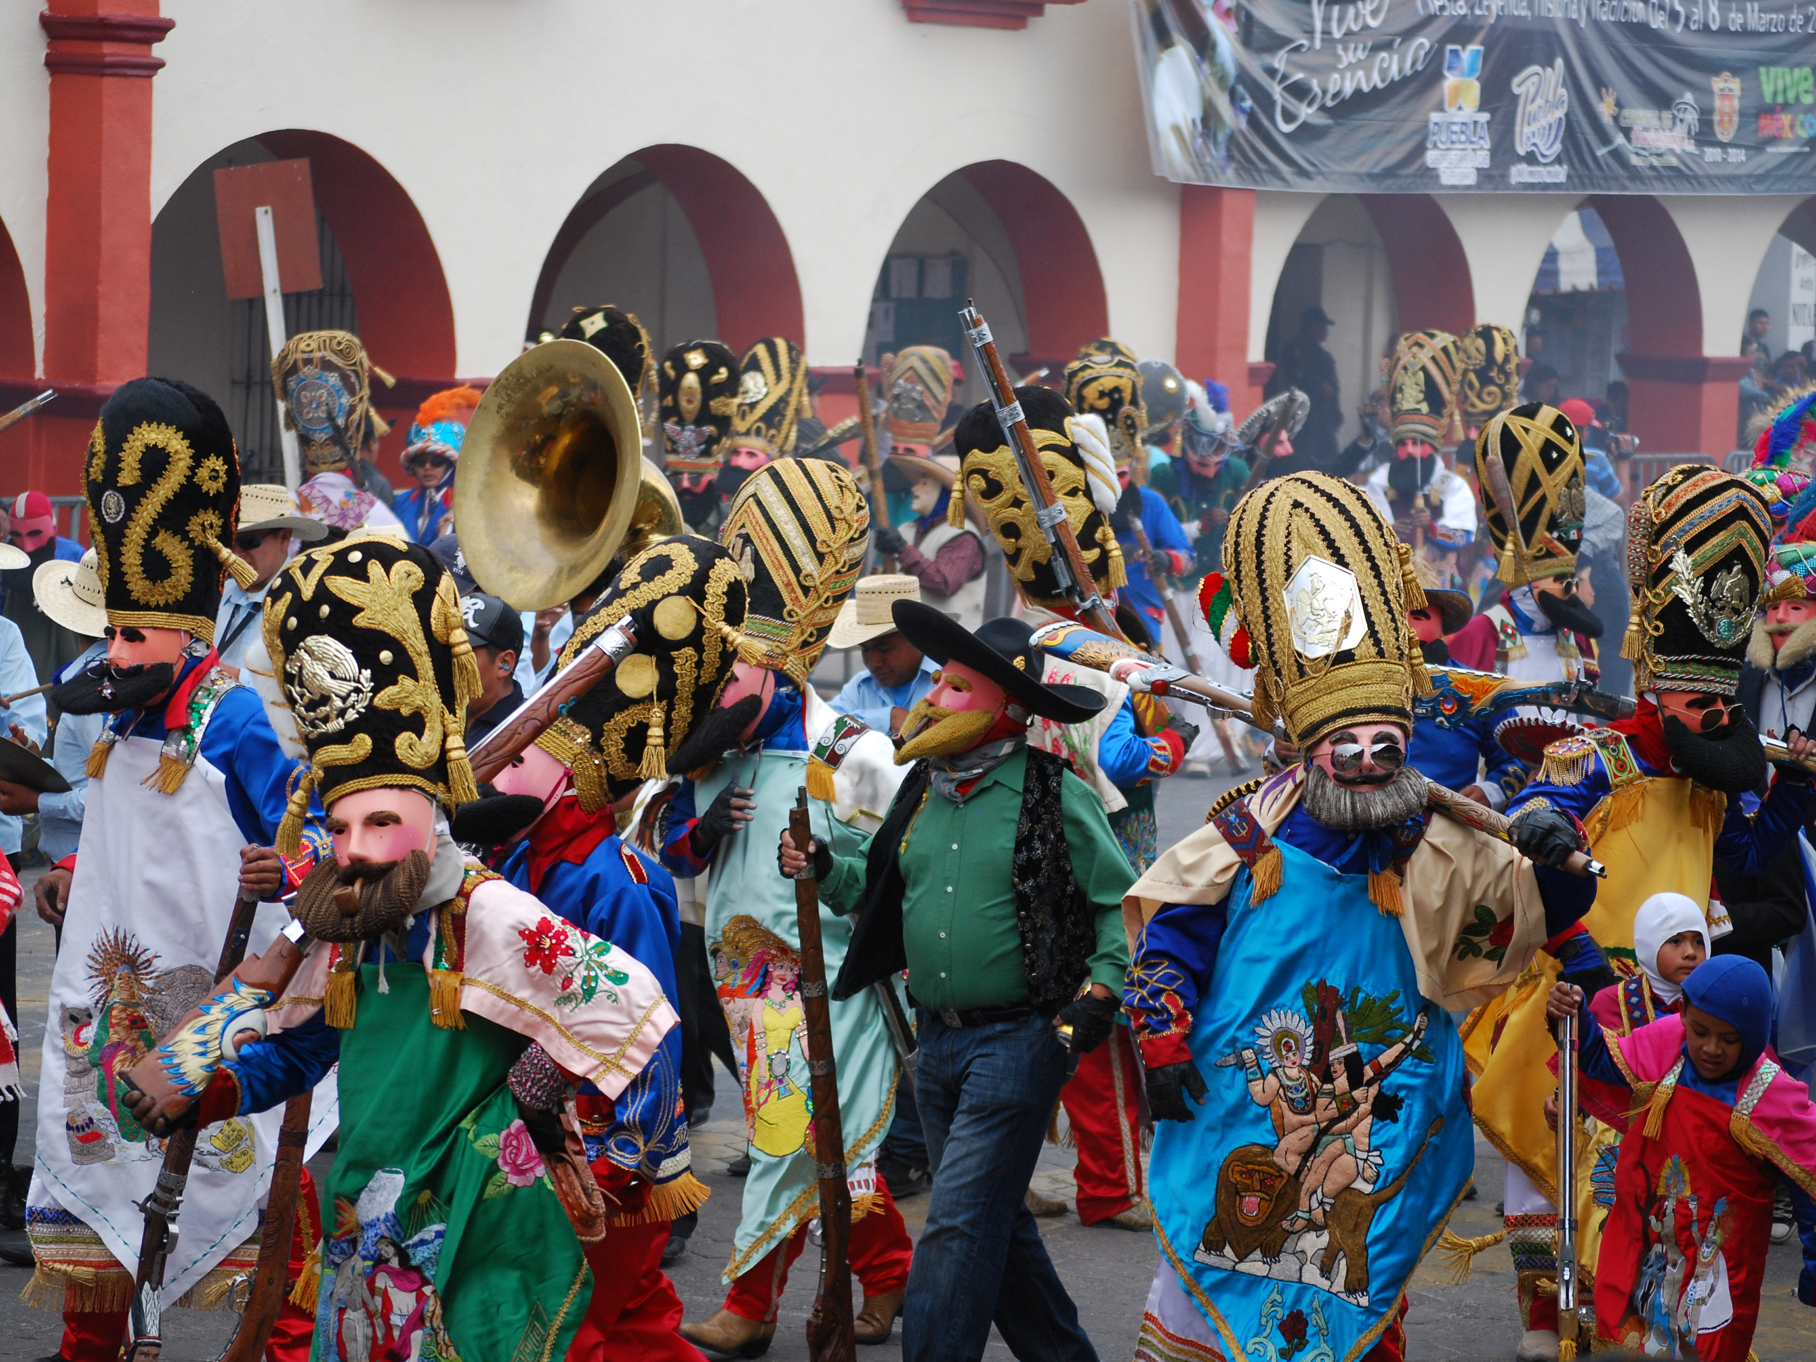
In your culture, are there any festivals where you wear costumes and masks?
Notes:
https://pixabay.com/en/mardi-gras-new-orleans-festival-1176483/

Slide 4
In your culture, do people honour ancestors?

Slide 5
What makes you afraid?

Slide 6
What do you think about evil?

Slide 7
Do you think death is the end or is there something after?

Slide 8
What makes you feel safe?

Slide 9
b. Halloween Jigsaw Activity

Slide 10
What is the link between Halloween and Celtic (Scottish, Irish, Welsh) culture?
Why are there costumes & masks at Halloween?
What is ‘guising’?
How will a child know that a house is open for ‘guising’ on Halloween?
Name one Halloween game.
Is there anything Christian about Halloween?

Slide 11
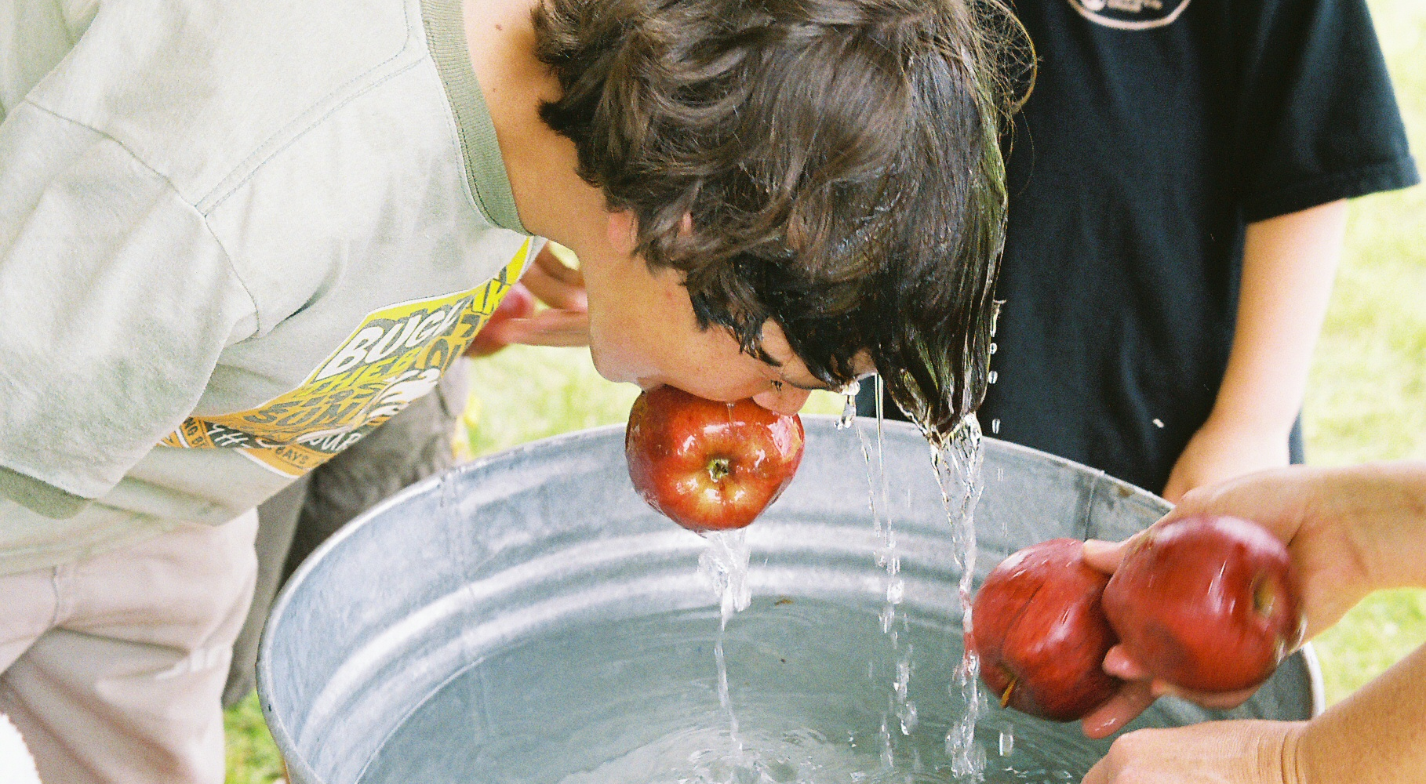
Let’s dook for apples!

Slide 12
c. Perspectives on our Intro Questions

Slide 13
What did Halloween say about our intro questions?
They believed in life after death – at Halloween, the ancient Celts believed the border between the worlds of the living and the dead is thin
They originally honoured ancestors, whose spirits were welcomed home at Halloween
They believed evil is real, something to be afraid of. They believed they could keep safe from evil spirits by wearing masks and costumes to trick them

Slide 14
Matching Activity
Christians often don’t celebrate Halloween because the Bible gives some quite different answers…
  To find out, match…
    An intro question (choose 4 out of the 6)
    with
    Something from the Bible
    with
    The photo on the screen

Slide 15
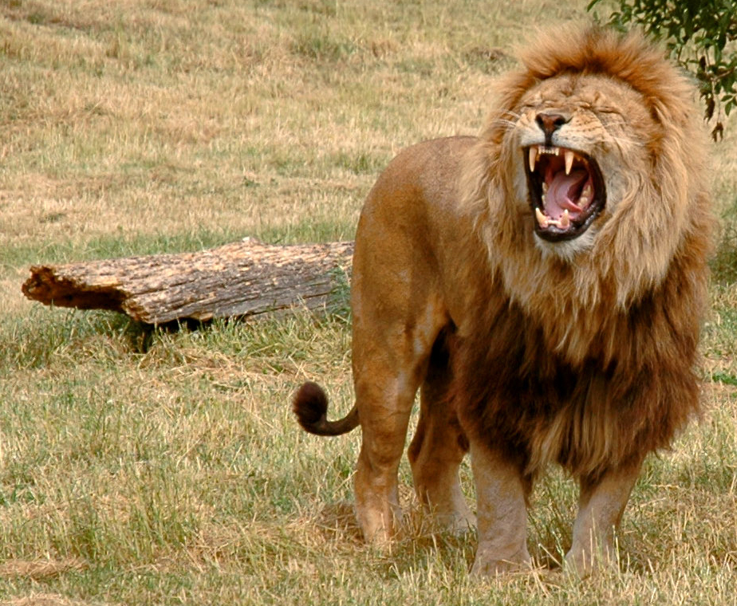

Question and verse?
Notes:
https://pixabay.com/en/old-couple-people-strangers-grunge-450742/

Slide 16
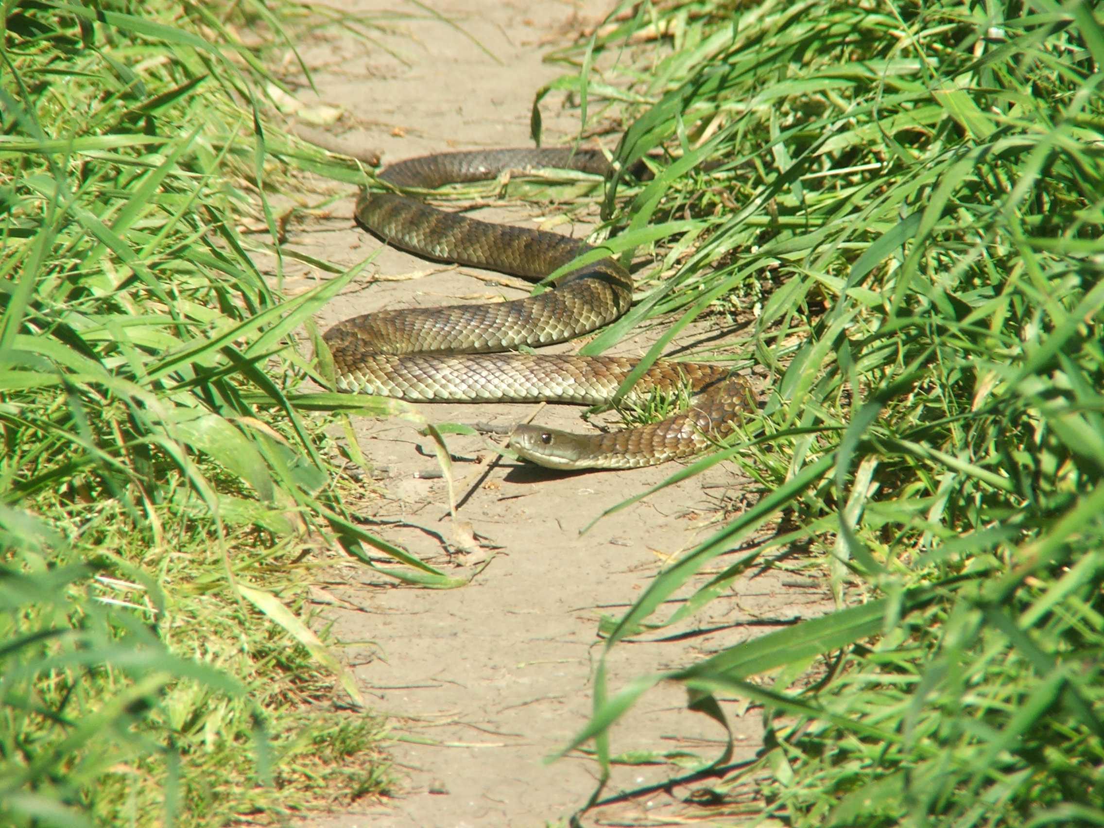
Question and verse?
Notes:
https://pixabay.com/en/sparrows-two-birds-pair-plumage-2763553/

Slide 17
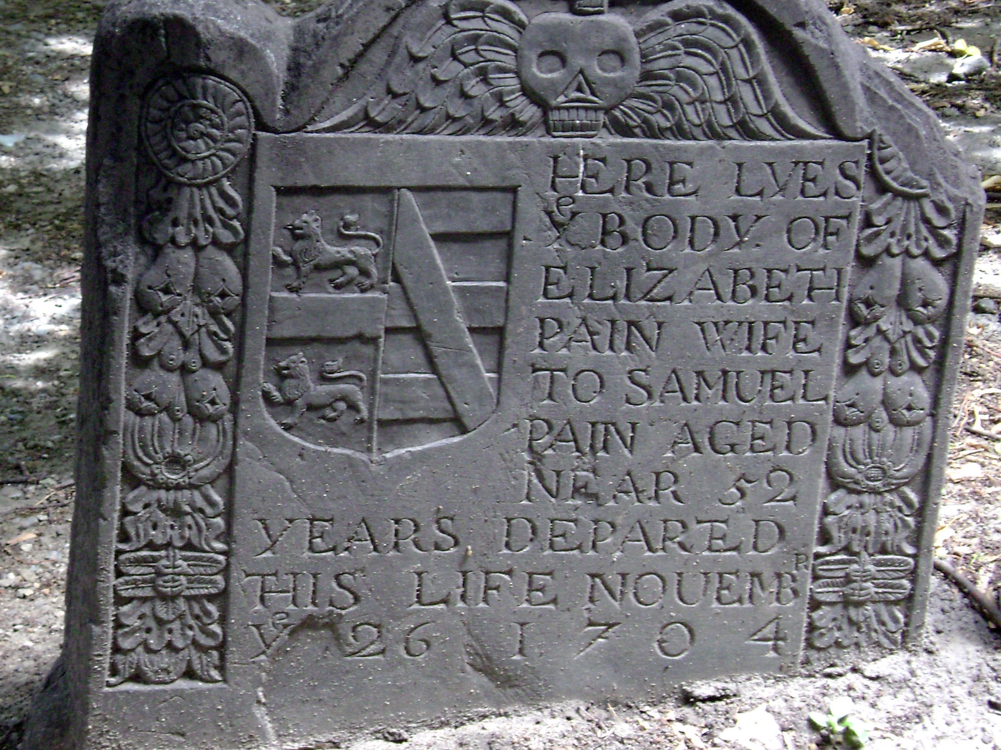
Question and verse?
Notes:
https://pixabay.com/en/lion-predator-dangerous-mane-3576031/

Slide 18
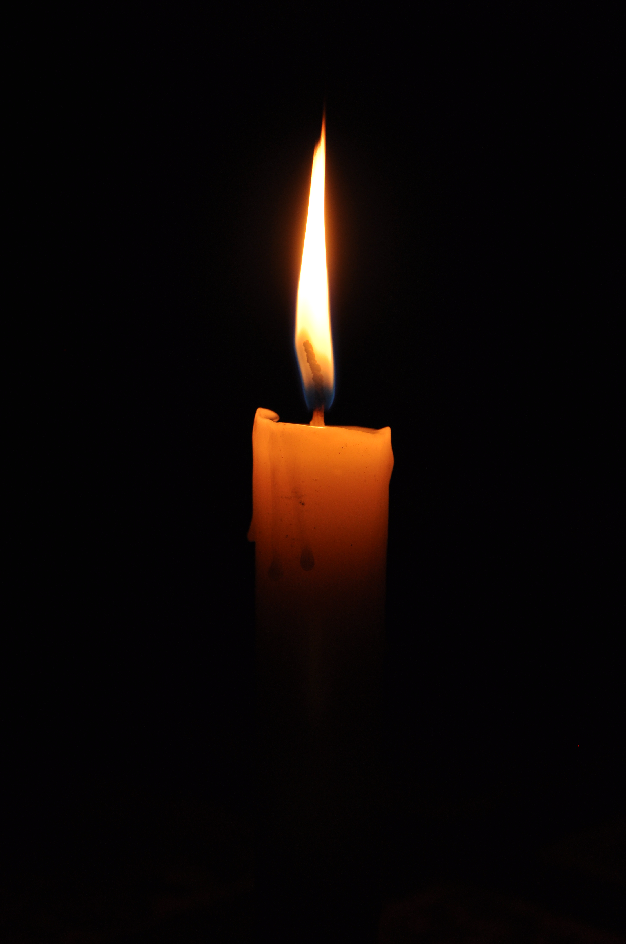
Question and verse?
Notes:
https://pixabay.com/en/candle-light-candlelight-flame-2038736/

Slide 19
Answers

Slide 20
Notes:
https://pixabay.com/en/old-couple-people-strangers-grunge-450742/

Slide 21
What do you think about evil?
Be alert and of sober mind. Your enemy the devil prowls around like a roaring lion looking for someone to devour.
I Peter 5:8 NIV
For from your heart come the evil ideas which lead you to kill, commit adultery, and do other immoral things; to rob, lie, and slander others.
Matthew 15:19 Good News Translation

Slide 22
Notes:
https://pixabay.com/en/sparrows-two-birds-pair-plumage-2763553/

Slide 23
What are you afraid of?
The fear of the Lord is the beginning of wisdom.
Proverbs 9:10 NIV

Slide 24
Notes:
https://pixabay.com/en/lion-predator-dangerous-mane-3576031/

Slide 25
Do you think death is the end
or is there something after?
For God loved the world so much that he gave his only Son, so that everyone who believes in him may not die but have eternal life.
John 3:16 Good News Translation

Slide 26
Notes:
https://pixabay.com/en/candle-light-candlelight-flame-2038736/

Slide 27
What makes you feel safe?
When Jesus spoke again to the people, he said, ‘I am the light of the world. Whoever follows me will never walk in darkness, but will have the light of life.’
John 8:12 NIV

